Slide 1
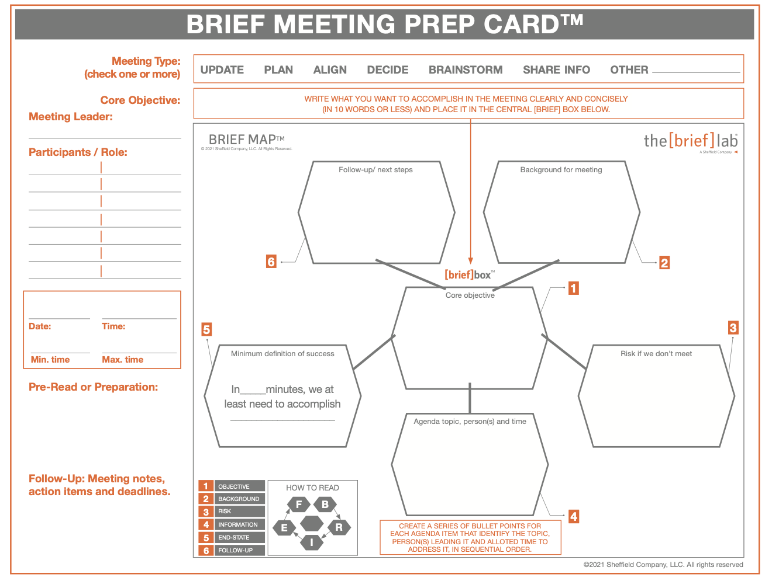
TEXT HERE

Slide 2
